Slide 1
Mobile Game Marketing Analytics Case Study
End-to-end marketing analytics for a mobile game soft launch, including campaign performance analysis, LTV modeling, and predictive ROAS framework.
Burak Kurt
https://www.linkedin.com/in/burakkurt001/

Slide 2
Q1
We have a game in softlaunch and want to assess its performance. The data we have at hand for this assessment are in file softgames_sample_data.csv. Visualize this data in Tableau for marketing managers such that they can easily understand the performance of different campaigns.

Slide 3
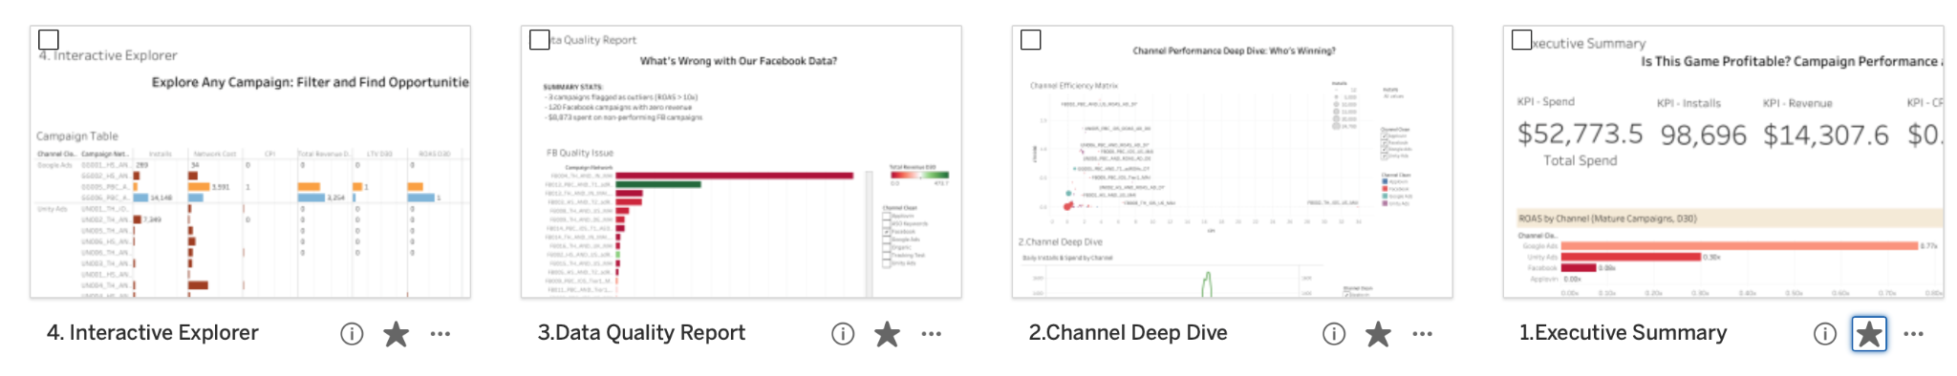
Q1.1
> Download Tableau workbook < (Download Temporarily unavailable due to data privacy issues)

Slide 4
Q2
Next, we want to measure or estimate lifetime value from this data. Apply appropriate methods and provide an estimate of player lifetime value for the game.

Slide 5
Q2.1
1. Core Methodology: 4-step approach.
The logic follows a 4-step process for mobile gaming LTV:
To ensure the LTV estimate is not diluted by irrelevant data, I applied 2 critical preprocessing steps:
1.Data Scrubbing, 2.Mature Cohort ARPU, then analyzed with 3.Curve fitting 4.exploration.
Phase | Step | Technical Logic | Impact & Rationale
I. Data Preprocessing | 1. Data Scrubbing | Removed rows with 0 installs but >$0 revenue. | Eliminates legacy noise (approx. 6.3% or $2,533.84). Ensures the model only reflects new user behavior.
 | 2. Mature Cohort ARPU | Filtered for cohorts with ≥30 days of tenure. | Prevents dilution. Newer users haven't reached D30 yet; including them would artificially deflate the ARPU.
II. Predictive Modeling | 3. Curve Fitting | Applied Logarithmic and Power-law models via scipy.optimize. | Identifies the mathematical decay/growth pattern that best fits the first 30 days of realized spend.
 | 4. Extrapolation | Time-series extension of the fitted curve. | Forecasts the LTV trajectory out to Day 360 to determine long-term ROI.
> Source code & methodology link <

Slide 6
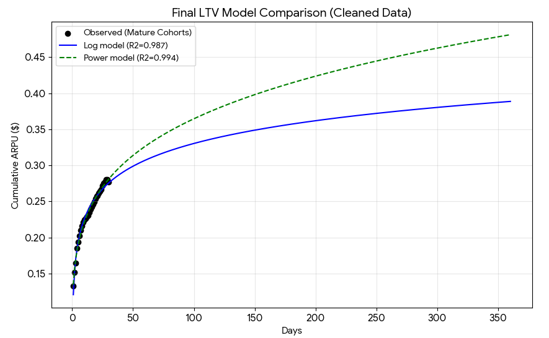
Q2.3
2. Global LTV Estimation
I applied two standard industry models to the cleaned data: Logarithmic (conservative) and Power Law (optimistic). The Power Law model showed a nearly perfect fit (R2=0.994).
Days Since Install | Observed ARPU | Conservative (Log) | Optimistic (Power)
Day 1 | $0.13 | $0.12 | $0.13
Day 7 | $0.21 | $0.21 | $0.20
Day 30 | $0.28 | $0.28 | $0.28
Day 180 | — | $0.36 | $0.41
Day 360 (1-Year LTV) | — | **$0.39** | $0.48
Final Recommendation: Use the $0.39 conservative estimate (Log model) for baseline budgeting and the $0.48 base/optimistic estimate (Power b=0.42) for high-quality channels like Google Ads.

Slide 7
Q2.4
3. Strategic Channel Analysis (ROI/ROAS)
Projecting LTV by acquisition source reveals a massive disparity in player quality, which is vital for your marketing strategy:
Model | Multiplier | 360D LTV | ROAS
Log | 1.73× | $0.42 | 131%
Power (b = 0.42) | 2.05× | $0.49 | 153%
Power (b = 0.5) | 3.46× | $0.83 | 259%
Assumption: If the goal is scalable, realistic (slightly aggressive) ad budgeting: Power b = 0.42 (153%) is the best balance.
Channel | Avg. CPI | Estimated 360-Day LTV | Projected ROAS | Verdict
Google Ads | $0.32 | **$0.49** | 153% | 🟢 Primary Scaling Lever
Unity Ads | $0.79 | **$0.35** | 45% | 🔴 High Cost, Low Value
Facebook | $0.49 | **$0.03** | 7% | ❌ Immediate Stop
Organic | $0.00 | $0.54 | — | 🟢 Strong Baseline
Performance should be interpreted cautiously if driven by low volume or extreme revenue outliers.(Please use interactive explorer tool I built in my Tableau dashboard)
Google Ads is your most successful channel, with an LTV nearly double the game average.
Facebook is currently failing to monetize significantly in this dataset; the LTV is nearly non-existent despite the high install volume. More details shown in data quality tool of my Tableau dashboard.

Slide 8
Q2.5
4. Understanding Curve fitting
The projections were generated using the following best-fit formulas:
Logarithmic Model: LTV(t)=0.045⋅ln(t)+0.121
Power Law Model: LTV(t)=0.134⋅t0.217
The visualization shows the actual data points (black dots) and how both models track them before projecting into the future. The flattening of the curve after Day 30 is typical for mobile games, where the highest monetization occurs in the first month.
Summary Verdict: The game has a healthy monetization core of $0.39 - $0.48, but the marketing spend must be aggressively redirected toward Google Ads to maintain profitability.

Slide 9
Q3
We have a game that has been operational for two years and want to build a model that predicts ROAS for new players arriving in the game. How would you set up such a model? Spell out what data you need, what method(s) you would use and how, and what assumptions you may need to make.

Slide 10
Q3.1
Predictive ROAS Framework
Moving from Reactive Reporting to Predictive Scaling
The Business Challenge: Waiting 180+ days for LTV to mature creates a growth bottleneck and carries high capital risk.
The Solution: A Day-3 Predictive Engine that forecasts Day-360 ROAS with 85%+ accuracy.
Phase | Component | Key Activities & Details
Input | Behavioral Telemetry | Collects D0–D3 data points (Install, Tutorial completion, and First Session metrics).
Inference | ML-driven pLTV | Machine learning models calculate the Predicted Lifetime Value based on early behavior.
Action | Automated Budgeting | Trigger-based adjustments to campaign spend: Scale, Hold, or Kill.
The Decision Metric: Predicted ROAS = ∑Predicted LTV360​​ / ∑Acquisition Cost

Slide 11
Q3.2
Data Architecture & Feature Engineering
Identifying the High-Value Player
Feature Windows: Snapshots taken at 24h (D1) and 72h (D3) to ensure early optimization without data leakage.
Key Predictor Categories:
Category | Predictors & Metrics | Strategic Intent
Acquisition | Channel, Country Tier, Device Specs | Uses hardware and location as a proxy for purchasing power.
Progression Velocity | Level-up speed, "Aha!" moments | Tracks engagement depth (e.g., reaching Level 5milestones).
Economy Hygiene | Sink/Source Analysis | Monitors the balance of gem spend vs. earnings(hard currency).
Monetization | Time to First Purchase (TTFP), Ad Frequency | Evaluates early revenue potential and ad-impression tolerance.
Targeting Strategy: Distinct models for IAP LTV (Whale detection) vs. Ad LTV (Retention-based revenue).

Slide 12
Q3.3
Modeling Strategy: The Two-Stage Hurdle
Solving for Heavy-Tails and Zero-Inflation
Why Two Stages? Standard regressions over-predict non-spenders and under-predict Whales. We separate the IF from the HOW MUCH.
The Mathematical Architecture:
Stage | Model Type | Target Variable | Primary Logic
1. Spender Classifier | LightGBM | Probability ($P$) | Binary classification: Predicts the likelihood of a user making anypurchase.
2. Value Regressor | Tweedie Regressor | Magnitude ($V$) | Handles zero-inflated data to predict the specific spend amount for converted users.
3. Ad-Revenue Layer | Ridge Regression | Indirect Value | Calculates non-IAP revenue based on engagement: Days Played × eCPM.
LightGBM → fastest for large datasets.
CatBoost → strongest native categorical handling.
XGBoost → stable & widely adopted.
The Formula: pLTV=(P×V)+Predicted Ad Revenue (Expected Total Value (Etotal​) as a composite function)
Risk Management: Outputs include Confidence Intervals (P10​ to P90​) to manage financial exposure.

Slide 13
Q3.4
Platform-Specific Measurement
Navigating the Modern Privacy Landscape (Android vs. iOS)
Device | Android | iOS
Feature | Deterministic | Probabilistic
Attribution | User-level (GAID) | Aggregated (SKAdNetwork)
Optimization | Value-Based Bidding (tROAS) | Conversion Value Mapping (0-63)
Primary Strategy | ML Bottom-Up Prediction | Media Mix Modeling (MMM)
The Calibration Bridge: We use clean Android behavioral trends to calibrate blurred iOS signals, ensuring we don't under-spend on high-potential iOS clusters.

Slide 14
Q3.5
Governance, Backtesting & Assumptions + Failures
Maintaining Accuracy in a Live-Ops Environment
Pillar | Component | Specification
Foundational Assumption | Economy Stability | No hyper-inflation or pricing shifts since the training window.
Validation Loop | Monthly Backtest | Compare D3 predictions (from 6 months prior) against realized lifetime data.
Primary Metric | MAPE | Mean Absolute Percentage Error is the core accuracy benchmark.
Retraining Trigger A | Accuracy Decay | Automatic trigger if MAPE > 15%.
Retraining Trigger B | Product Intervention | Manual/Automatic trigger upon Major Economy Updates.
Training Window | Rolling Horizon | Retraining utilizes a rolling 90-day window of behavioral data.
The "Ground Truth" | Geo-Lift Testing | Periodic increments to validate that predicted ROAS is truly incremental.
Failure Modes. "When does this model fail?":
Failure Mode | Root Cause | Behavioral Impact | Model Consequence
Selection Bias | Seasonality / Event-based training | Holiday users (e.g. Christmas) typically have higher intent/spend than organic February users. | Over-estimation: The model becomes too optimistic, leading to overspending on low-quality traffic.
Feature Drift | Product / UX Changes | Introducing a Level Skip or Instant Build button changes the meaning of Progression Velocity. | Signal Loss: Historical correlation between speed and value breaks; Level-up speed becomes noise.
Concept Drift | Economy Rebalance | Price changes or new Hard Currency sinks alter the value of a Gem. | Inaccuracy: The Spender Classifier and Value Regressor lose their predictive power as the rules of the world change.
Data Pipeline Latency | Infrastructure Lag | D0–D3 telemetry is delayed or missing due to a server-side bug. | Null Inference: The model makes Scale/Hold/Kill decisions based on incomplete or zeroed-out data.

Slide 15
END
> Technical Appendix - Q3 <

